Slide 1
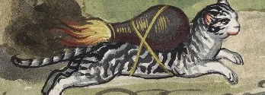
ADVANCED CODE REUSE ATTACKS: A NEW FRAMEWORK FOR JOP
Detail from Folger Shakespeare Library, V.b.311, f. 129r
Bramwell Brizendine
Doctoral Dissertation Defense
Dakota State University
March 27, 2019
Notes:
Why is there a 16th century rocket cat on the first slide? It is a good question. We will soon find out.

Slide 2

Introducing the JOP ROCKET
Jump-Oriented Programming
Reversing Open Cyber Knowledge Expert Tool
Notes:
The acronym is as acronyms go, is somewhat clunky, but it serves us quite well. Let us return to our lovely 16th century image.
Why do we have a cat with a rocket on its back? This actually comes from the Folger Shakespeare Library, believe it or not. There was a period of time when cats would be loaded with flammable devices to set fire to castles or cities that would otherwise be inaccessible.
That’s really want the JOP Rocket does. The intent is to reach what would otherwise be inaccessible due to anti-ROP heuristics, anti-ROP defenses.

Slide 3
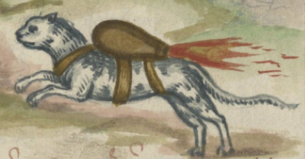
the JoP ROCKET: DID I INVENT JOP?
Certainly not.
The literature provides us with examples of JOP going back a decade: Bletsch; Chen, et al.; Erdődi; Checkoway and Shacham
For those interested in JOP though, there was a somewhat serious problem: lack of tools to address it.

Slide 4
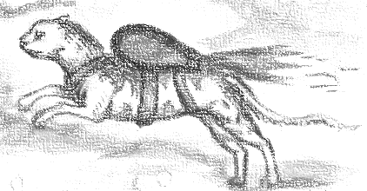
BASICS of JOP
Instead of using the stack to facilitate control flow, we craft a dispatch table ourselves.
The stack is replaced by the dispatch table.
The RET that we use as glue to connect our ROP gadgets? Verboten! Forget about it.
We will use a dispatcher gadget as a program counter to advance either forwards or backwards, thereby reaching our functional gadgets.
These functional gadgets are tantamount to the traditional ROP gadgets, only...they end terminate in an indirect jump or call.
The functional gadgets will then jump back to the dispatcher gadget, allowing us to own the control flow.

Slide 5
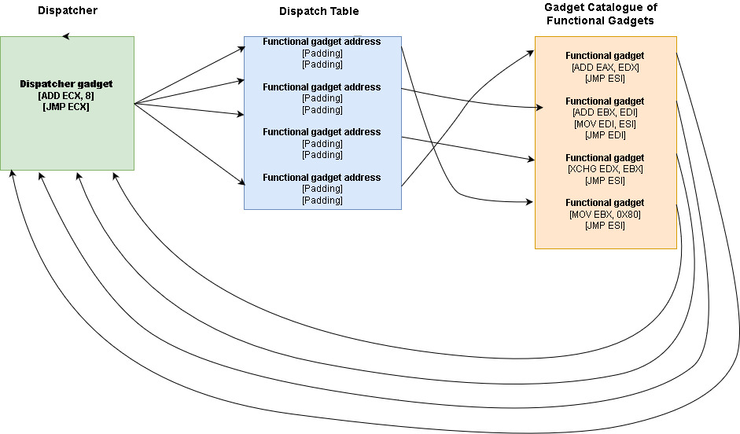

Slide 6
Important Terms
Dispatcher gadget: This allows us to advance forwards or backwards in dispatch table, thereby reaching the functional gadgets. E.g. ADD ECX, 8 / JMP ECX
Dispatch table: This is a list of addresses for functional gadgets alongside necessary padding.
Functional gadgets: These are the gadgets that “do stuff,” allowing us to manipulate registers, add values, etc., to achieve arbitrary computation. They jump back to a register containing location of dispatcher gadget.

Slide 7
Background for Research Problem
Sophisticated code mitigation strategies such as DEP, ASLR, CFG, EMET and third-party ROP solutions make exploits more cumbersome in a Windows environment.
CFG provides defense against JOP, but Windows 7 lacks CFG. ☺
Windows 7 represents a significant target.
Windows 7 comprises 42.8% of all Windows machines as of December 2018.
Windows 7 is su.pported until January 2020 with three years of additional paid updates planned.
On Windows 10, some of CFG’s defenses against indirect jumps and calls could be overcome by Back to the Epilogue (BATE) attack.
CFG is not foolproof and other attacks may be possible.
Only hardware CFI will provide a true solution against JOP.

Slide 8
Manual Techniques
Would-be attackers were left to their own devices to utilize various reversing tools to discover indirect jumps or indirect calls.
ROP tools, such as Mona, provided very minimal support--more or less non-existent.

Slide 9
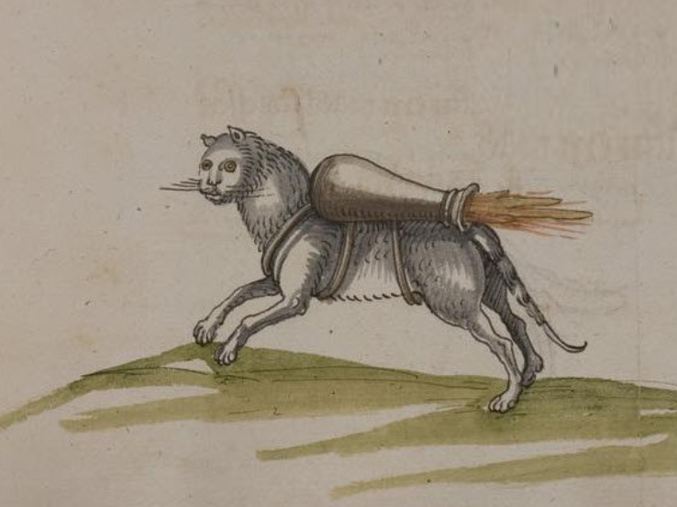
Research Problem: Background INfo
Existing tools, e.g. ROPgadget and Mona, provided only very limited support, to the extent that they are of only very marginal value.
These are ROP tools, not JOP tools!
JOP is rather complex and finding gadgets simply is not a straightforward process such as with ROP.

Slide 10
Research Problem
There is a lack of tools and automation to facilitate building JOP exploits, as the current workflow makes it a manual, tedious, time-consuming process (Bletsch, 2011; Checkoway & Shacham, 2010; Quiao, 2015; DAvi, 2015; Erdődi, 2013; Min, 2012).

Slide 11

Research Questions
How can software most effectively implement in an automated fashion the discovery of JOP functional gadgets?
How can software most effectively implement in an automated fashion a means of discovering dispatcher gadgets?
How can software most effectively classify these gadgets into relevant categories and allow these to be displayed on demand, as a means to provide utmost utility to the security researcher?
How can potentially unusable, highly impractical gadgets most effectively be expunged from results, in an automated fashion?
How can software most effectively ensure that no potential JOP gadgets of value are missed?

Slide 12
Purpose of the Study
This is design science research to create a powerful, versatile framework to best allow for facilitating the creation of exploits that utilize JOP.

Slide 13


Broader Implications... JOP IS A SIDE Door!
We can have organizations or companies that rely on Windows 7, and conceivably could for a few more years, until January 2023. They may employ all available security including anti-ROP defenses, yet it may be inadequate.
JOP creates a side door that let’s the attacker be able to perform exploit, in situations where ROP otherwise might be heavily mitigated.
Was too painful and tedious before for most to bother, but that pain has been eased and replaced with pleasure, since the JOP ROCKET is a joy to use.
Underscores the importance of hardware-based control flow integrity (CFI) as a solution.
Control Enforcement Tracking (CET). Gotta have it!

Slide 14
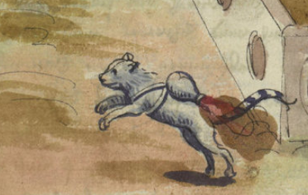
NEEDS for Jump-ORIENTED PROGRAMMING
NEED to take control of some area of memory in which to place payload, e.g. heap.
NEED a way to subvert control flow to dispatcher gadget.

Slide 15
Advantages of JOP
Can bypass ROP defenses and anti-ROP heuristics, e.g. EMET, kBouncer, ROPecker, G-Free, ROPGuard
May detect too frequent RET instructions; more.
Can subvert control flow without having to utilize RET instructions.
We use JMP or CALL in place of RET instructions.
Can confuse analysts who may not understand it as it is not as well known as ROP.

Slide 16
Disadvantages Of JOP
Much fewer JOP gadgets exist, reducing the attack surface.
ROP gadgets are vastly more plentiful and easier to use!
Less gadgets means it may be much more challenging or even infeasible to mount an attack with JOP where ROP would be possible.
The set up is far more complex and less simple than ROP: learning curve.
The biggest problem thus far: lack of tools, the need to do it through manual processes:
This makes it all but impossible for hobbyists and purely an academic exercise.
Plausible, but too painful for most.
Discourages all but the most skilled and knowledgeable.

Slide 17
Design Science Artifacts For This Research
An instantiation of the framework, embodying all methods, i.e. the JOP ROCKET;
An improved method for discovering JOP functional gadgets while applying exclusion criteria;
An improved method for discovering JOP dispatcher gadgets while applying exclusion criteria;
A method for classifying JOP gadgets into categories based on Turing catalogue features, while applying exclusion criteria;
A method for storing and printing JOP gadgets in appropriate data structures, according to classification;
A method for statically enumerating and obtaining modules in the import table and beyond, as well as obtaining their JOP gadgets;

Slide 18
Artifact 1: Instantiation of the FRAMEWORK, the JOP ROCKET
It provides the ability to extract the text section, find the target opcodes, convert the bytes to disassembly, and use exclusion criteria to eliminate gadgets that would be deemed impractical.
Embodies all methods and more.
14,000+ lines of object-oriented, well-tested Python.
Static analysis tool, but lots of functionality.
Did not want it to be dependent or reliant upon existing tool, e.g. WinDbg, Immunity.
Can be used to limited degree on multiple platforms--any that support the necessary dependencies, Python, Capstone, Pefile and win32con libraries.
Some more limited functionality on non-Windows systems.
Can only do search on one binary; it cannot find and scan a binary’s DLLs on non-Windows systems, since they are not there!
Intended for well-formed, normal PE files, not malware!

Slide 19
Artifact 1: Instantiation of the FRAMEWORK, the JOP ROCKET
Tremendous customization available. It is very granular and specific, allowing users to change what it is they are looking for.
Allows the analyst tremendous flexibility to find the JOP gadgets they need, whether dispatcher gadgets, functional gadgets that do specific operations, gadgets that modify certain registers.
Very intuitive and minimalist, yet powerful and versatile.
Reasonable default settings, but provides the flexibility via the UI as needed, to dig deeper.

Slide 20
Artifact 2: improved method for discovering JOP functional gadgets
Improves upon existing algorithms.
Ensures that “no stoned is left unturned.”
All possible permutations of opcodes are created, disassembled, and then searched for gadgets.
Employs robust and extensive regular expressions to exclude nonsensical gadgets.
Do we need to see garbage like sbb byte ptr [eax - 0x5e5b10c4], al ? No!
Filters out useless, impractical gadgets.
Some binaries generate numerous gadgets, and it can make finding the good ones like finding a needle in a haystack.

Slide 21
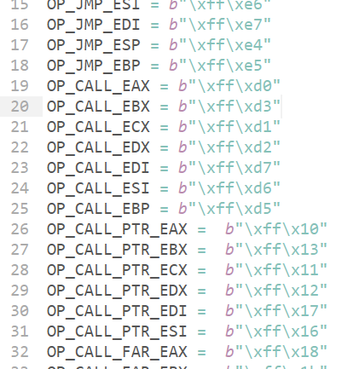
Unintended Instructions
Remember two’s complement?
This can mean a lot of values with FF bytes...and thus can create a good deal of unintended instructions.
Those FF bytes can be very useful for JOP.
-1851170 = FFE3C0DE
FF E3 = JMP EBX
The reality? Without unintended instructions, JOP just would not be feasible.
The JOP ROCKET is better and smarter in terms of how it will find all possible unintended instructions, whilst discarding the useless ones.

Slide 22
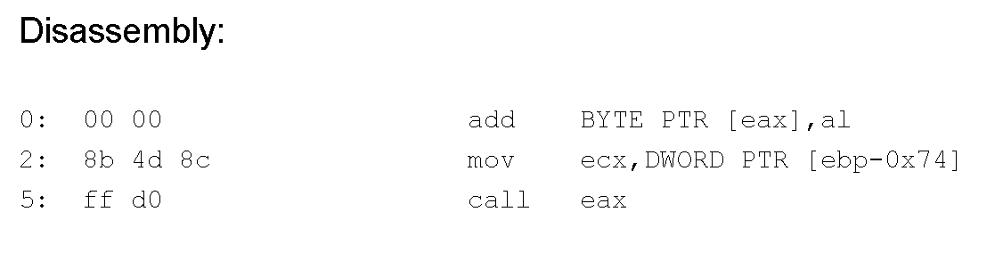
Unintended Instructions & Verification
The JOP ROCKET provides output for a gadget. The gadget is created using unintended instructions.
With WinDbg, we can see what Assembly instructions would be executed at the address provided.
IDA Pro confirms that these are unintended instructions.
With Defuse Assembler we see those opcodes do produce the unintended instructions.

Slide 23
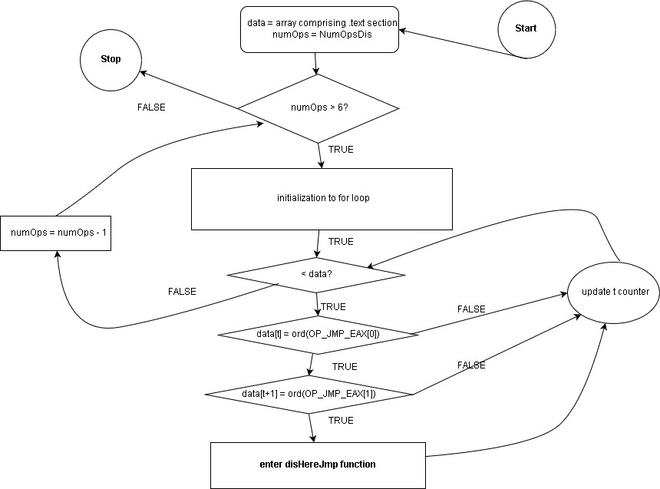
Method To Discover JOP Gadgets

Slide 24
Artifact 3: method for discovering JOP dispatcher gadgets
This also reworks an extant algorithm.
All the disassembly for feasible gadgets are then searched with robust exclusion criteria.
Searching initially for ones with ADD, ADC, SUB, SBC a register or value.
These are the BEST possible ones.
Others that are far less practical for obvious reasons: IMUL, MUL.
Multiplication or division via shifting right or shifting left: very impractical, but feasible. Searches if there is a left shift or right shift by 1 or 2.
Could only go in one direction a few times at most, and then would need to subtract a large value from register holding dispatch table, and then “restart.” Repeat this process as many as times as needed.
Would need a large area of heap to control and additional logic to make this work!
This is a novel contribution, and a way to potentially expand viable dispatcher gadgets

Slide 25
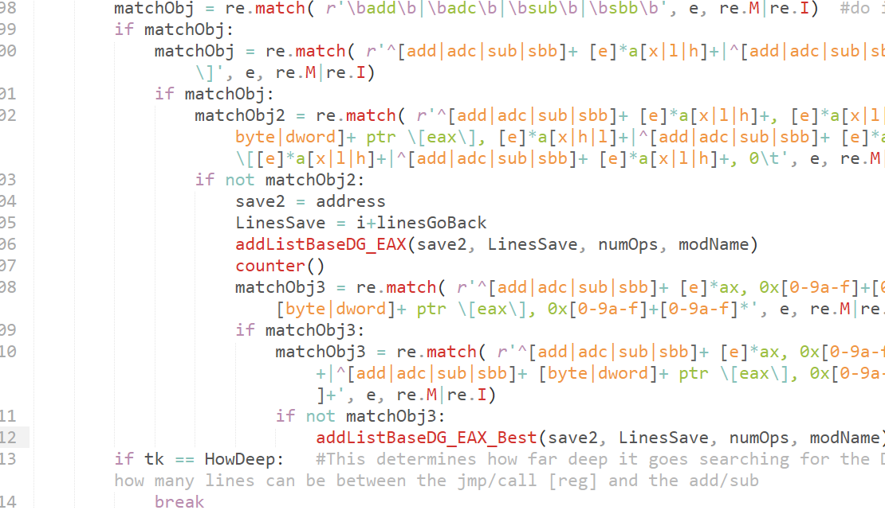
Finding Dispatcher Gadgets
Dispatcher gadgets are scarce, particularly good ones.
No need to rescan the binaries; just examine what was found.
Uses existing gadgets found to generate the disassembly and apply regular expressions to find viable dispatcher gadget candidates.

Slide 26
Artifact 4: method for classifying JOP gadgets into categories
Performs classification based on Turing-complete features and more.
Being able to rapidly access some results in an organized, easy to use fashion, will make analyst’s work with JOP much easier.
If you have 6000 or 50000 total gadgets, how can you find the ones you need?
Are you looking for ones that jump to EAX, EBX, ECX, etc.?
Ones that modify specific registers?
Ones that perform certain specific operations, e.g. ADD, SUB, MOV, XCHG, etc.
143 classifications exist.
The analyst an be very specific and granular about what they want or need.

Slide 27
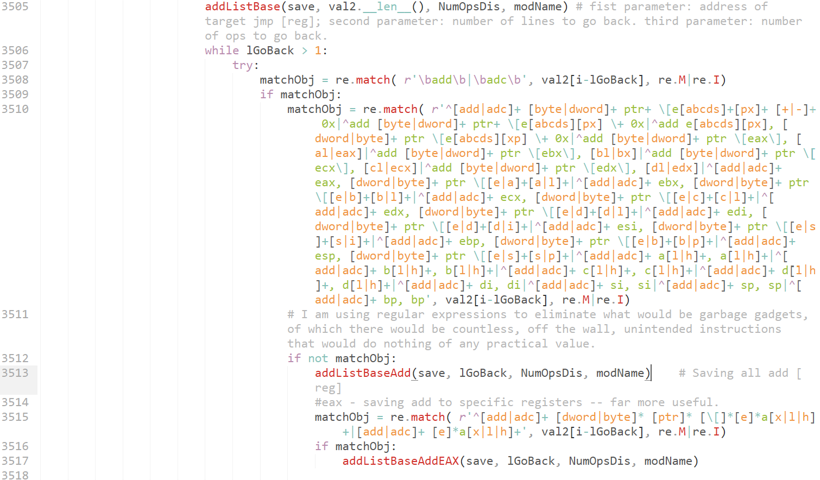
Utilizing Regular Expressions
Regular expressions can be used in the disHereJmp and disHereCall functions to locate specific functional gadgets.
This shows the RE to find a functional gadget that does ADD. More classification and exclusion criteria are used to find gadgets that modify each reg.

Slide 28
Artifact 5: method for storing and printing JOP gadgets in appropriate data structures
Research presents a novel way of storing and printing disassembly for JOP gadgets.
At no time are any opcodes or disassembly stored--only minimal bookkeeping data.
Bookkeeping information is stored in hundreds of data structures;
This would be fewer in a less limited programming language.
Object-oriented approach is used.
Each object holds the module’s .text section and all the relevant data structures. One binary might have 20 or more modules, and thus there would be 1 object for the executable and 20 for the DLLs.
Once it is time to print data to terminal or screen, it can be done instantaneously.
The only time it takes is if there is a large amount to print to terminal.
Capstone is used to produce the disassembly. It is given the correct objects and bookkeeping data to produce the necessary gadgets on the fly, to print to screen or disk.

Slide 29
Artifact 5: method for storing and printing JOP gadgets in appropriate data structures
Gadgets are printed to files and to screen.
Files are generated based on classification, e.g. MOV EAX, MOV SHUFFLE, ADD EDX, etc.
The analyst can specify what they wish to print.
Once the algorithms have been run, everything can be printed immediately.
Users can also produce a .csv, showing total number of gadgets for each classification.
This can help them make an informed decision on whether or not a binary is likely to be worth exploring.
Tremendous customization about how a user can print content.

Slide 30
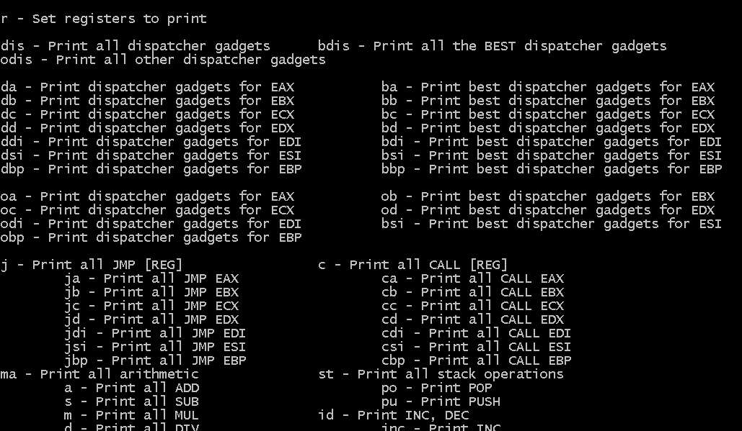
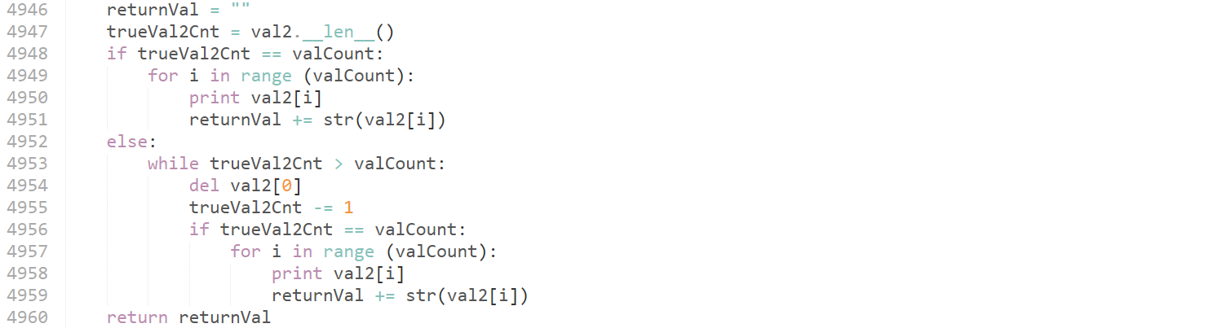
Printing Data...Many Options
Excerpt from disHereClean, helper function for printing
Very fast, printing to terminal and to files
Can customize based on operations, registers, etc., or simply print all.
Takes keyboard shortcuts as input.

Slide 31
Artifact 6: method for statically enumerating and obtaining modules and their JOP gadgets
This is a static analysis tool, and as such cannot as easily find modules that would normally be loaded, but are not in the Import Address Table (IAT).
This tool provides additional functionality to discover some of these other modules statically.
No functionality to statically load modules, in order to extract .text section and then obtain gadgets.
Easy to do dynamically with Immunity or WinDbg, but harder when it is all static!
Forced to come up with a way to reliably obtain file locations for modules, so they can be scanned.
Answer: Use the Windows API!
Uses LoadLibraryEx to load the module, GetModuleHandleW to return a handle, and GetModuleFileNameW to obtain the file location.
The IAT does not provide file location, nor do any of the libraries used.
This won’t work on non-Windows OS, as they lack Windows API as well as the needed modules.
Devised original logic to find the file location if GetModuleHandeW returned a NULL.

Slide 32
Artifact 6: method for statically enumerating and obtaining modules and their JOP gadgets
As this is a static analysis tool, there these modules are not magically loaded and extracted.
Their file location must first be discovered, so the .text can be extracted and their gadgets discovered and analyzed.

Slide 33
Validation
Followed Wieringa and Hevner, et al., to provide validation.
Utilized single-case mechanism experiment to highlight efficacy and utility of tool.
Without JOP ROCKET, there would be no way to generate all the JOP functional gadgets, JOP dispatcher gadget, not to mention meticulously classify each!
Without JOP ROCKET, only time-consuming, laborious and tedious manual discovery of gadgets, repeatedly searching for a needle in a haystack.
Single-case mechanism experiment designed to validate new technology.
The artifact was subjected to appropriate simulations replicating real-world context.
Tested 32 real binaries, encompassing a broad range of applications, small, large, commercial, and open source, to ensure the tool works as intended.
Utilized multiple reverse engineering tools to verify accuracy of output: correct addresses, correct disassembly, and correct offsets.
There is no margin for error: one byte off could mean improper results!

Slide 34
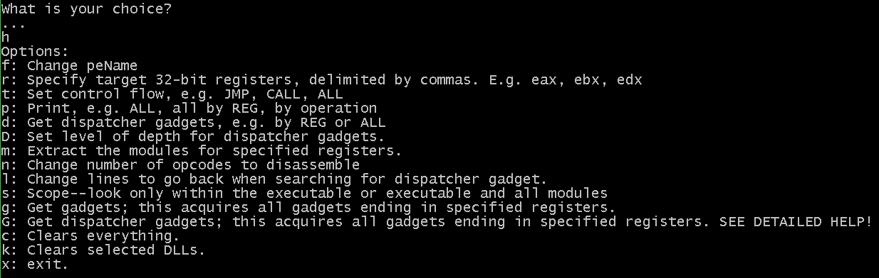
Sample UI

Slide 35
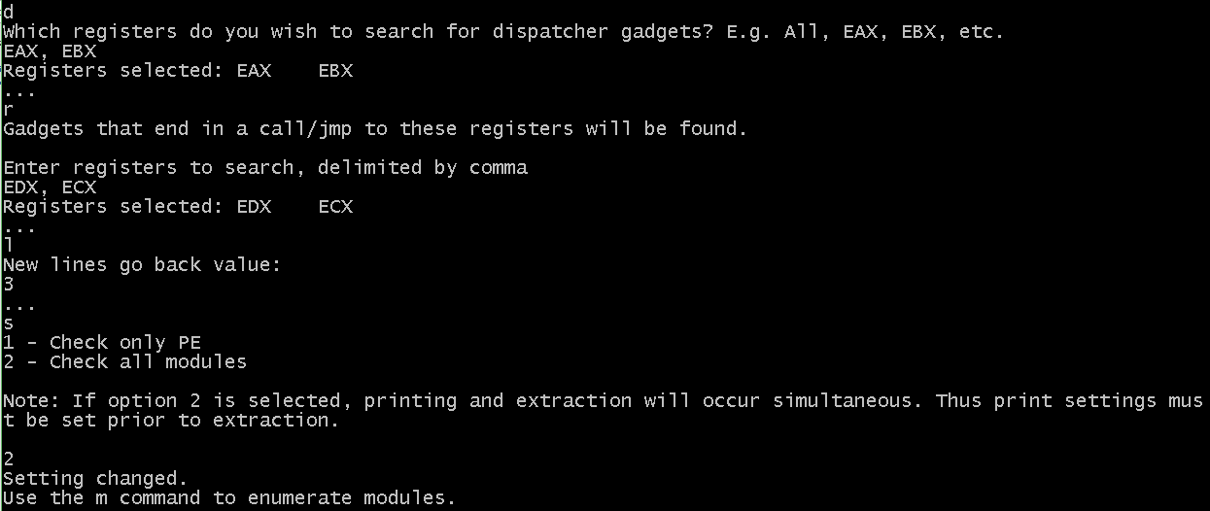
Sample UI

Slide 36

How about Some Results?
Now that we can appreciate the contributions made by the JOP ROCKET, let’s look at some results obtained.

Slide 37


Slide 38


Slide 39


Slide 40
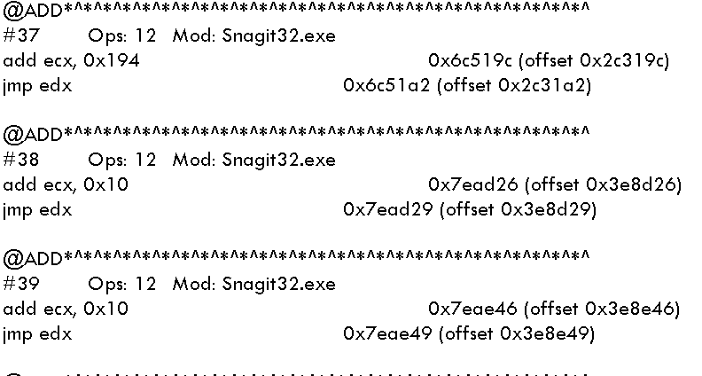
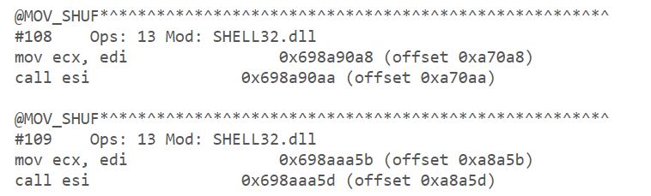
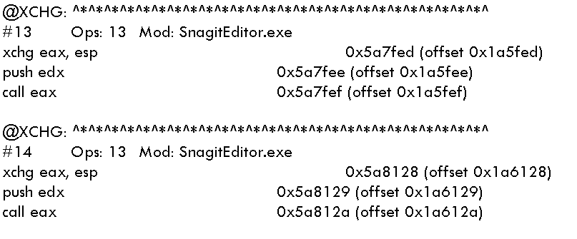
Sample Output
f

Slide 41

Recommendations
Attackers:
As mitigations become more robust, explore other attack methods outside of the norm.
Develop appropriate tools to help automate this wherever possible.
Defenders:
Utilize an OS that employs Microsoft’s CFG or other third-party CFI solution.
Work towards utilizing hardware-based CFI, such as the forthcoming CET.

Slide 42
Future Work
Expand coverage to 64-bit OS.
Expand coverage to other architectures.
Expand to other advanced code-reuse attacks, e.g. Counterfeit Object-oriented Programming.

Slide 43



Questions About The ROCKET?

